Slide 1
Enterprise Workforce Management Platform
Phase 1 Proposal: In-House Scheduling Engine, SDLC Blueprint, Required Timeline & Stakeholder Expectations

Slide 2
Strategic Context & Business Case
Transitioning from manual, spreadsheet-driven operations to a centralized enterprise scheduling engine.

Slide 3


Business Opportunity
Current Operational Challenges
Strategic In-House Solution
Spreadsheet Reliance: Decentralized Excel planning causes scheduling conflicts and manual calculation errors across sites.
Centralized WFM Platform: Unified system for roster creation, shift planning, and real-time coverage tracking.
High Recurring Cost: Expensive per-seat vendor license fees for legacy third-party tools like NICE & Verint.
Zero Seat Licensing: Fully owned software IP with zero recurring per-agent vendor subscription costs.
Data Fragmentation: Lack of a single source of truth for rosters, skills, and leave tracking.
AI-Ready Foundation: Clean structured data architecture prepared for Phase 2 automated ML forecasting.

Slide 4




Core Objectives & Value Drivers
Operational Speed & Efficiency
Cost & Governance Control
Compress roster creation timelines from multiple days down to hours. Planners receive dynamic templates, automated validation, and instant publish capabilities.
Eliminate external software licenses while providing full audit trails, role-based access control, and centralized coverage tracking across all operational units.
90%
Reduction in manual spreadsheet scheduling overhead
100%
Owned IP platform with zero third-party per-agent seat fees

Slide 5
SDLC Architecture & Tech Stack
End-to-End Software Development Life Cycle methodology, stack, and functional modules.

Slide 6
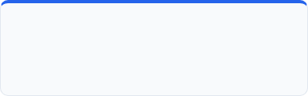




Software Development Life Cycle (SDLC)
1. Requirements & Discovery
2. System Architecture
3. Iterative Engineering
Eliciting business rules, shift structures, leave policies, and site hierarchies. Creating Business Requirement Documents (BRD) & Functional Specs.
Designing database schemas in SQL Server, UI/UX wireframes/prototypes for scheduling canvas, and defining RBAC security controls.
Sprint-based engineering in .NET MVC (C#) & HTML5/jQuery UI. Building user roles, roster master, capacity planner, and rule engines.
4. Testing & Quality Assurance
5. Deployment & Cutover
6. Maintenance & Hypercare
Unit testing, system integration testing (SIT), security VPTA vulnerability audits, load testing, and formal User Acceptance Testing (UAT).
Production environment provisioning on IIS, database migration, CI/CD automated release cutover, and planner end-user onboarding.
Post-launch 30-day hypercare support, performance monitoring, bug fixes, and transitioning platform baseline to Phase 2 AI/ML roadmap.

Slide 7





Phase 1 Functional Modules
1. User & Org Setup
2. Roster & Capacity Engine
3. Builder UI & Analytics
Role-based access (RBAC), domain single sign-on (SSO), hierarchical modeling for LOBs, operational sites, skill matrix, and site calendars.
Employee master import, skill tagging, leave approvals, capacity planning workspace, FTE requirement modeling, and shift assignment templates.
Interactive drag-and-drop schedule builder, version locking/history, real-time staffing coverage, agent utilization, and system audit logging.

Slide 8
Technology Stack Blueprint
Architecture Layer | Selected Technology | Technical Rationale & Capability
Application Core | .NET MVC Framework (C#) | High-performance enterprise backend with robust MVC architecture and security controls.
User Interface | Custom UX / jQuery / HTML5 | Fast, responsive interactive scheduling canvas with minimal footprint and high client compatibility.
Database Engine | Microsoft SQL Server | Relational data integrity, high-throughput transactional processing, and enterprise audit capabilities.
Web Hosting | Internet Information Services (IIS) | Hardened Windows Server hosting with Windows Authentication integration and SSL termination.
DevOps & Source | Azure DevOps / Git | Automated CI/CD release pipelines, backlog management, and secure central code repository.

Slide 9
Required Timeline & Expectations
Detailed schedule duration, milestone gates, resource commitments, and stakeholder success criteria.

Slide 10



Required Timeline & Critical Milestones
Months 2–7
Post Launch
Sprint Engineering: 12 bi-weekly sprints building Org Hierarchy, Roster Master & Builder UI.
Hypercare & Handoff: 30-day post go-live operational support, team training & AI roadmap.
Gate 2: Code Freeze
Gate 4: Operational Sign-off
Month 1
Months 8–9
Requirements & Architecture: BRD creation, DB schema, UI/UX prototypes & CI/CD setup.
QA, Security & Cutover: SIT execution, VPTA penetration test, business UAT & IIS go-live.
Gate 1: Specs Sign-off
Gate 3: Production Go-Live

Slide 11

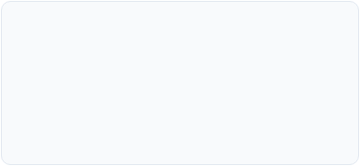
Stakeholder Expectations & Commitments
From Executive Leadership
From WFM Operations SMEs
From IT & Infrastructure
Budget sign-off for Phase 1 execution (₹1.50–2.50 Cr).
10–12 hrs/week time commitment in Month 1 for BRD rules.
SQL Server & Windows IIS VM provisioning in Month 1.
Sponsorship for organizational change management.
Bi-weekly sprint review attendance & feedback.
Domain Active Directory (SSO) integration support.
Full-time involvement during Month 8 UAT execution.
Security architecture & VPTA audit clearing.
Approval of dedicated project steering committee.

Slide 12



Project Success Criteria & Expectations
Operational Efficiency
Data & Compliance Quality
Financial Return (ROI)
Expectation: Roster creation time reduced from 3 days to under 4 hours per planning cycle.
Expectation: 100% elimination of spreadsheet formula errors and unauthorized schedule overrides.
Expectation: Total elimination of 3rd-party per-seat vendor licensing subscriptions.
Metric: 90% savings in planner labor hours across operational units.
Metric: Full capital cost payback expected within 14 months of go-live.
Metric: Complete audit trails and zero compliance non-conformances.

Slide 13
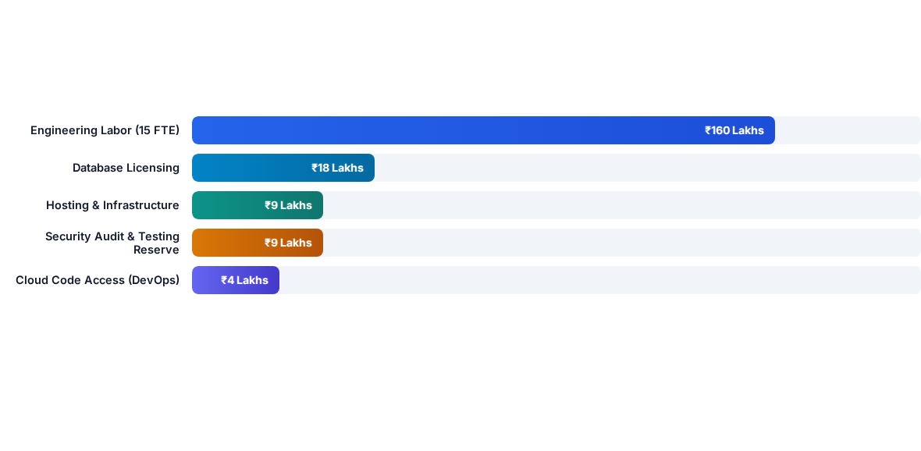
Phase 1 Investment Breakdown

Slide 14
Team Structure & Governance Model
Dedicated Cross-Functional SDLC Team (15 Headcount): 1 Project Manager, 1 Product Owner, 1 Solution Architect, 1 Tech Lead, 4 .NET Developers, 2 Frontend Developers, 2 QA Engineers, 1 DevOps Engineer, 1 UI/UX Designer.
Requirements & Testing SMEs: Dedicated WFM Operations SMEs for business rules elicitation & UAT validation; HR/Operations leads for site hierarchy alignment.
IT & Security Governance: DBA support for SQL Server provisioning, Infrastructure team for IIS deployment, and Security Team for VPTA audit.

Slide 15
Executive Decision Needed
Approval requested for Phase 1 budget (₹1.50–2.50 Cr), required 9-month schedule, team allocation, and stakeholder commitments.

